Slide 1
Airline Passenger Satisfaction
DATA 602 - Team 5
Brett Allen, Eeshani Gundi, Sruthi Kapudasi, Bharath Prabhakaran, and Nandhu Unnikrishnan

Slide 2
Outline
01
02
03
04
05
06
Describing the Data
EDA Insights
Model Selection
Results from analyzing nulls, unique values, and more.
Visualizations and findings from the dataset.
Selecting the most appropriate models based on the data.
Model Training &
Evaluation
Observations & Solution
Future Work
Linear separability and observations from model training/evaluation along with a quick demo.
Possible methods for improving model performance.
Measuring precision, recall, F1 score, accuracy and more.

Slide 3
Describing the data
01

Slide 4
Airline Passenger Satisfaction Dataset
For our project, we've utilized the Airline Passenger Satisfaction dataset from Kaggle containing 103,594 records and 22 features. This dataset provides a comprehensive view of various factors influencing passenger satisfaction during air travel.
Data: https://www.kaggle.com/datasets/teejmahal20/airline-passenger-satisfaction

Slide 5
Data Cleaning
Formatting
Null Values
Removed unnecessary column names, and formatted column names and row values.
Identified null values and dropped rows with null values after careful consideration.
Uniqueness
Imputation
Identified categorical features by analyzing uniqueness.
Applied simple imputation to improve model performance.

Slide 6
Steps for Data Cleaning
1. Removed unnecessary columns: Unnamed: 0, 'id' columns are not necessary for analysis.
2. Formatting column names
3. Formatting row value names
4. Adjusting the 0-5 ambiguity (0: Not Applicable, 1-5: Rating)
5. Converting specific columns to suitable data types: category type and integer type
6. Checking for column significance:
1. We’ve checked for insignificant columns where a binary column for satisfaction is created, mapping "Satisfied" to 1 and "Neutral or Dissatisfied" to 0.
2. We assessed insignificant columns by checking categorical columns for low unique values and dominant categories.
3. Coming to numerical columns, we've checked for low variance and performed correlation analysis to find columns with low correlation to the binary satisfaction target.

Slide 7
EDA Insights
02

Slide 8
Visualizing the data
Visualizations help us to uncover interesting patterns and trends in the data, such as:
The impact of flight delays on passenger satisfaction
The relationship between class of travel and satisfaction levels
The influence of in-flight services on overall satisfaction

Slide 9
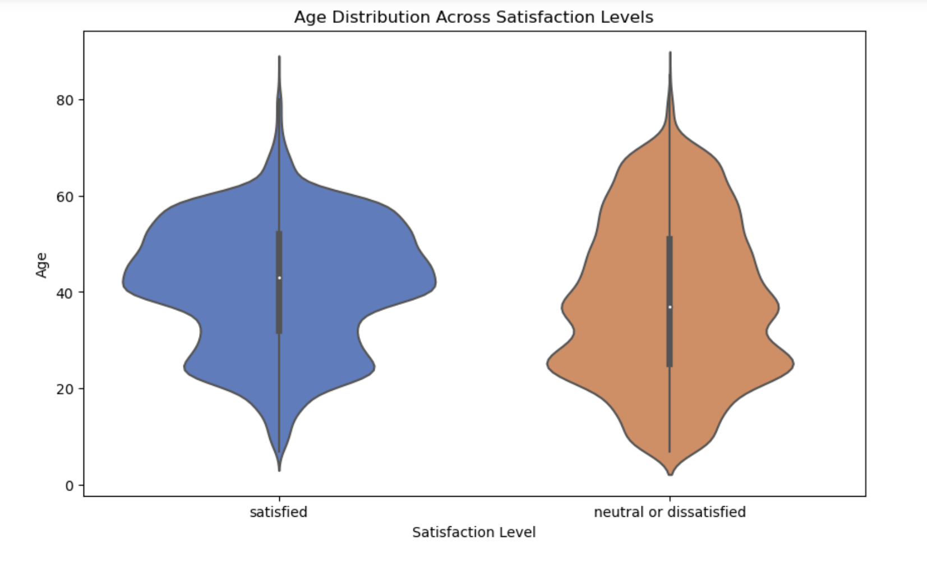
Satisfaction by Age
Shows the distribution of passenger satisfaction across different age groups.
Younger passengers display a broader range of satisfaction levels, while older passengers tend to have more consistent satisfaction ratings.
This pattern suggests that age may play a role in how passengers perceive their flight experience

Slide 10
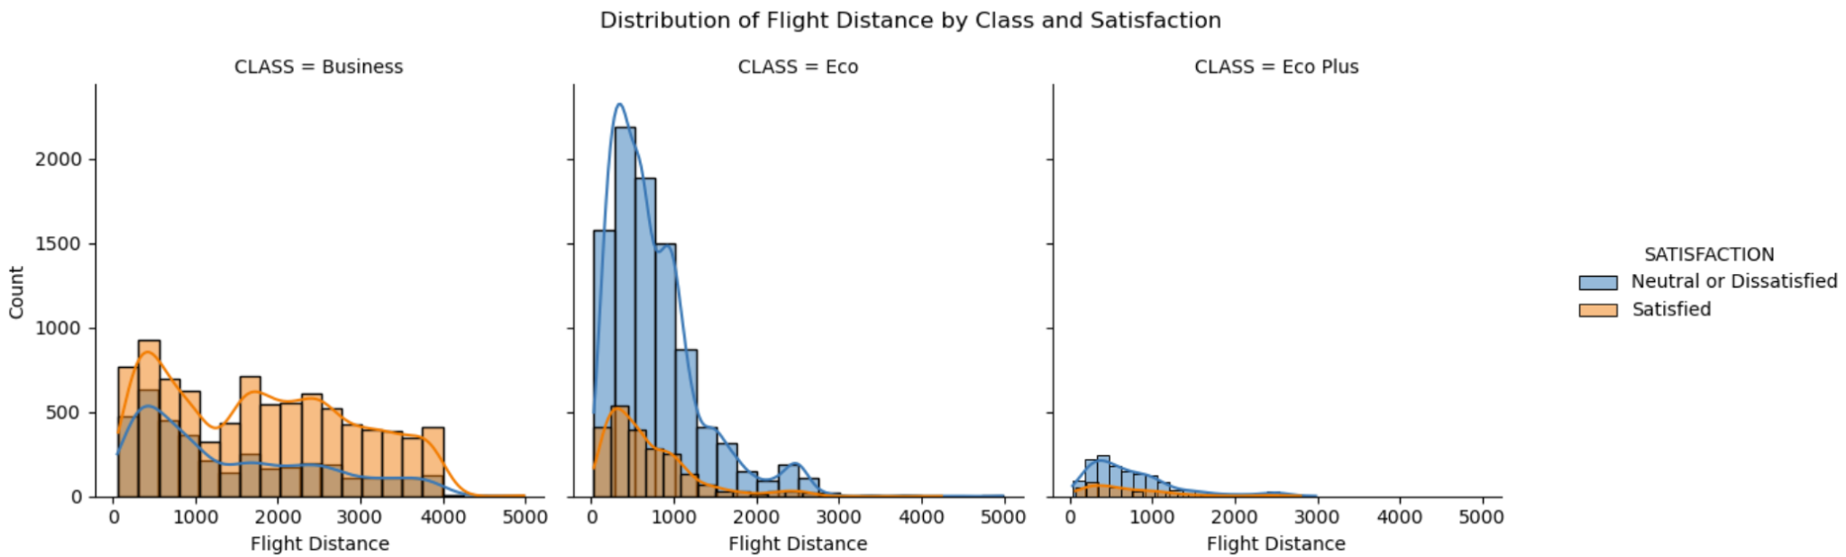
Distribution of Flight Distance
Histogram: Distribution of Flight Distance by Class and Satisfaction (Bi-variate Analysis)
- Flight distance varies by class and affects satisfaction.
- Business class: Shorter flights, higher satisfaction.
- Eco class: Longer flights, satisfaction linked to distance.
- Eco Plus class: Medium flights, satisfaction moderately linked to distance.

Slide 11
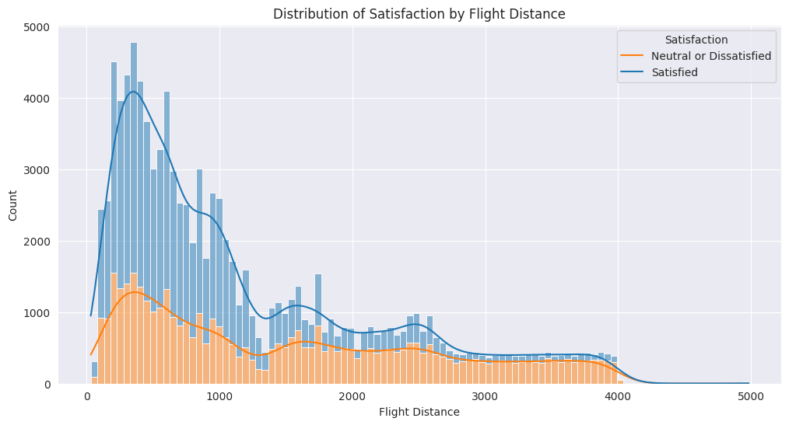
Satisfaction by Flight Distance
Trend
Negative correlation between flight distance and satisfaction.
Observation
Customers are less satisfied with longer flights.

Slide 12
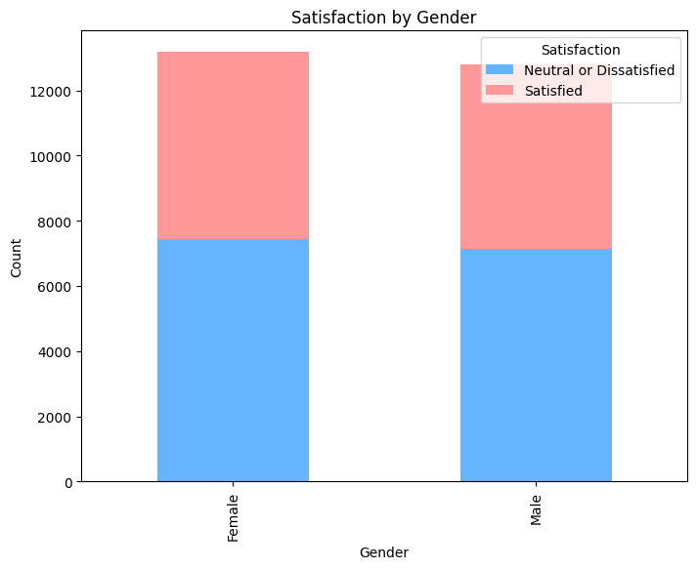
Satisfaction by Gender
Shows the distribution of passenger satisfaction across the two genders.
Both males and females have a similar distribution of satisfaction
Larger proportion of customers falling into the "Neutral or Dissatisfied"
Gender does not seem to have a significant impact on satisfaction levels
Notes:
While dissatisfaction dominates for both genders, females appear to have a slightly higher satisfaction rate than males. females slightly outnumbering males. Females make up 50.7% of the total, while males represent 49.3%. This indicates a nearly balanced gender split,

Slide 13
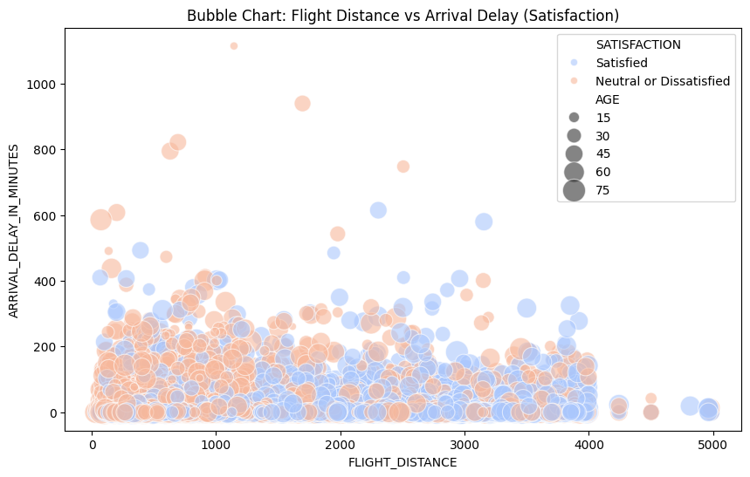
Flight distance vs Arrival delay
No strong correlation found between flight distance, arrival delay, and satisfaction
Longer flights and greater delays generally decrease satisfaction, but with many exceptions
Age has minimal impact; younger passengers are slightly more tolerant of delays on shorter flights
Some of the longest, delayed flights still have satisfied customers, hinting service quality may play a larger role in satisfaction
Notes:
While dissatisfaction dominates for both genders, females appear to have a slightly higher satisfaction rate than males. females slightly outnumbering males. Females make up 50.7% of the total, while males represent 49.3%. This indicates a nearly balanced gender split,

Slide 14
Model Selection
03

Slide 15
Model Selection
Criteria for Model Selection:
Accuracy: The model should accurately predict passenger satisfaction.
Precision: The model should minimize false positive predictions (incorrectly predicting a satisfied passenger as dissatisfied).
Recall: The model should minimize false negative predictions (incorrectly predicting a dissatisfied passenger as satisfied).
F1-Score: A balanced metric that considers both precision and recall.
ROC Curve: A visual representation of the model's performance at various classification thresholds.
Confusion Matrix: A detailed breakdown of correct and incorrect predictions.
Computational Cost: The model should be computationally efficient, especially for real-time applications.
Interpretability: The model's decisions should be understandable and explainable.

Slide 16
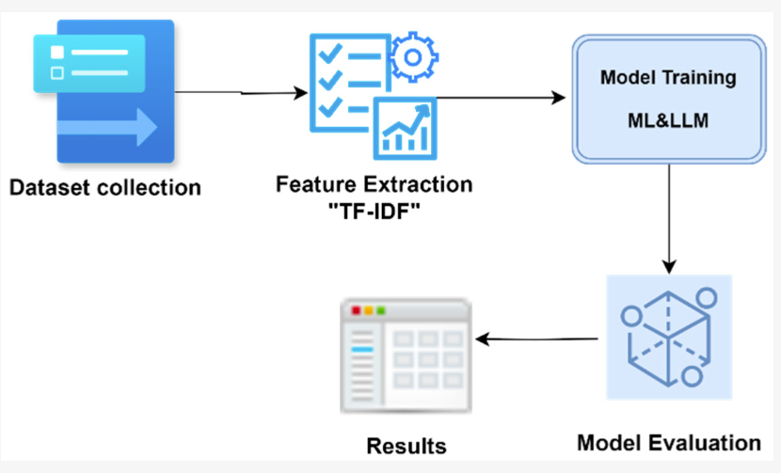
Models
The models we have selected for training are as follows:
Logistic Regression
Gradient Boosting
XGBoost
SVC
Random Forest Classifier
AdaBoost

Slide 17
Model Training & Evaluation
04

Slide 18
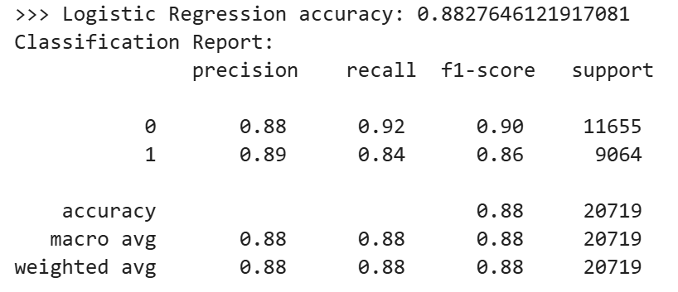
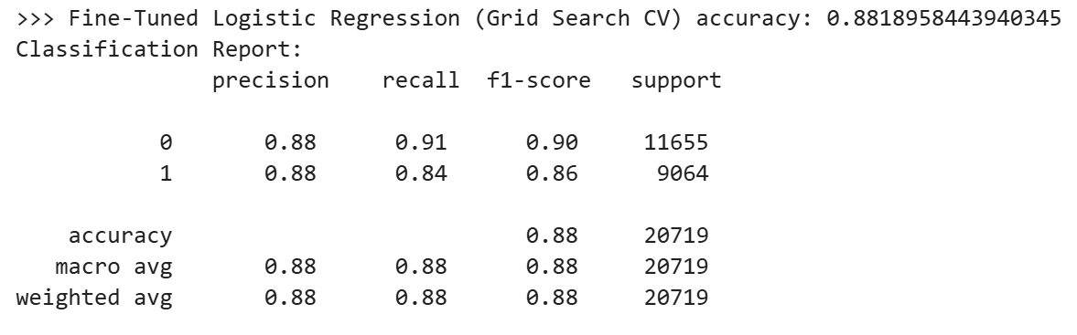
Logistic Regression
Base Model
Fine-Tuned (Grid Search CV)
Data Transformation: Quantile
Parameters: C=0.1, max_iter=1000, random_state=42
Accuracy: 88.3% – moderate performance.
Observation: Model has better precision for satisfied class and worse recall for satisfied class, indicating a lower false-positive rate for the satisfied class at the expense of a higher false negative rate.
Data Transformation: Quantile
Parameters: C=0.1, l1_ratio=0.1, max_iter=50, penalty='l1', random_state=42, solver='saga'
Accuracy: 88.2% – slightly lower than base model.
Observation: Similar performance metrics to base model. Cause for slight decrease in model accuracy is likely due to a non-linear separability issue along with incompatibility of solvers other than saga with Elastic Net regularization.

Slide 19
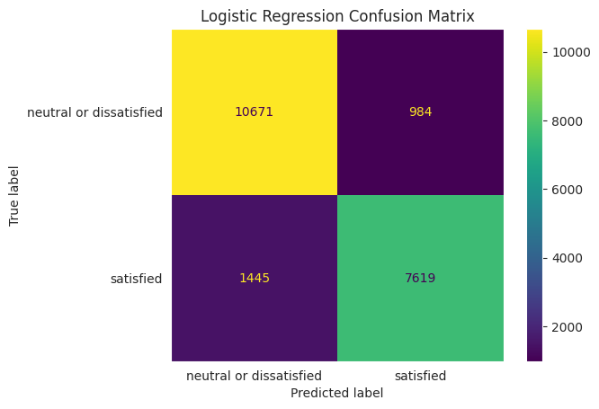
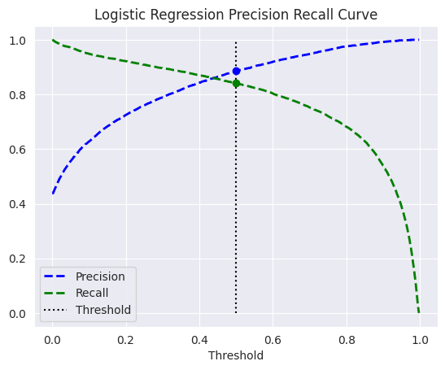
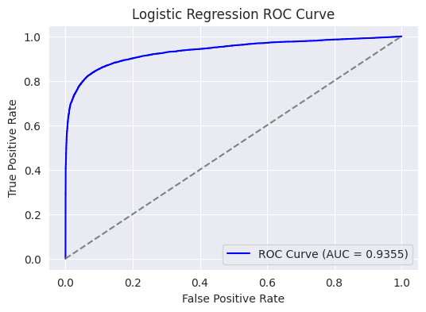
Logistic Regression Performance Metrics
Higher precision vs. recall
True positive rate hindered by precision issues.
More false negatives than false positives
Outliers are likely causing lower recall (e.g., the model is being “careful” in predicting the positive class).
Threshold set to 0.5
Higher precision vs. recall with different perspective
Moderately “good” precision and recall curves.
High AUC score - moderately good performance.
Approximately 93.5% probability that the model will correctly rank a randomly chosen positive example higher than a randomly chosen negative example.
Model has an ideal ability to distinguish between positive and negative classes.

Slide 20
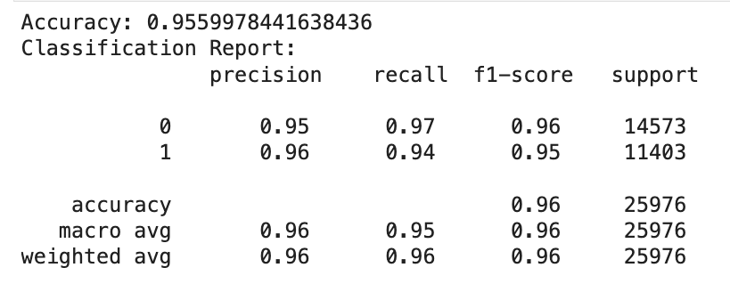
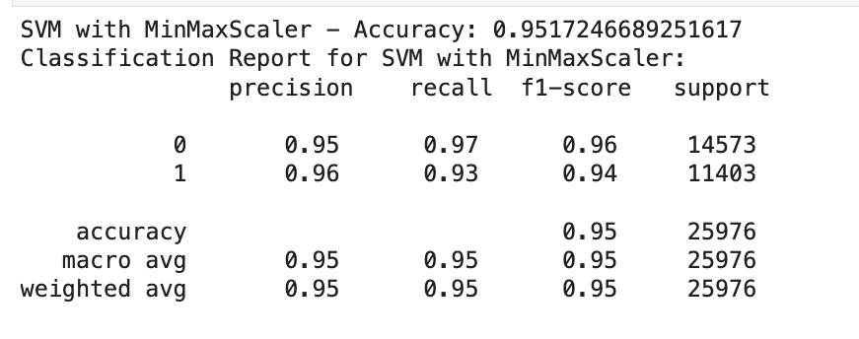
SVM (Support Vector Machines)
StandardScaler
MinMaxScaler
Accuracy: 95.6% – high overall performance.
Precision for Satisfied: 96% – accurate in predicting satisfied passengers.
Recall for Satisfied: 94% – captured most satisfied passengers with few missed cases.
F1-Score: 0.95 – balanced precision and recall.
Accuracy: 95.1% – slightly lower than StandardScaler.
Precision for Satisfied: 96% – similar precision as StandardScaler.
Recall for Satisfied: 93% – slightly lower recall, missing a few more satisfied passengers.
F1-Score: 0.94 – balanced but slightly lower than StandardScaler.

Slide 21
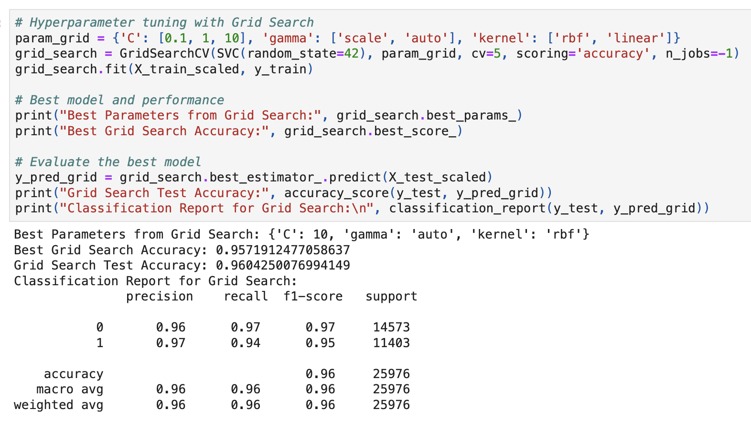
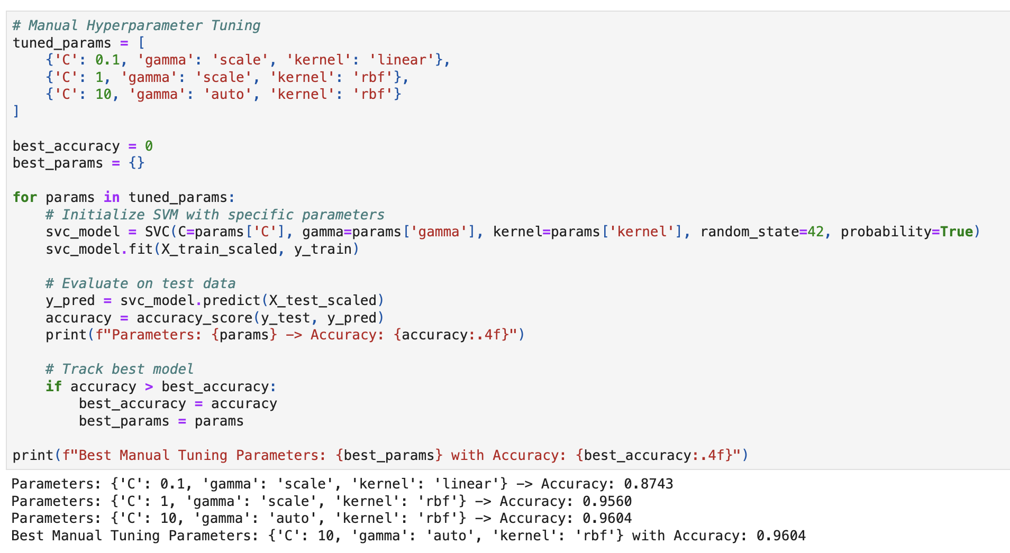
Hyperparameter Tuning Results
Best Parameters: C=10, gamma=auto, kernel=rbf
Accuracy: Achieved 96% accuracy with the best parameters.
Higher C Value: Allowed a more complex decision boundary, improving classification accuracy.
RBF Kernel: Helped capture non-linear patterns in the data for better separation of satisfied and dissatisfied passengers.
Consistent Across Methods: Both Grid Search and Manual Tuning confirmed these parameters as optimal.

Slide 22
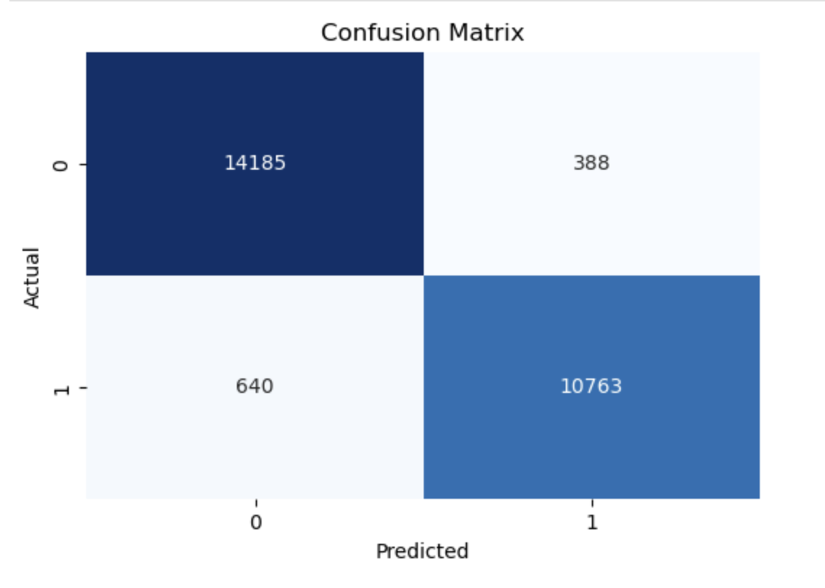
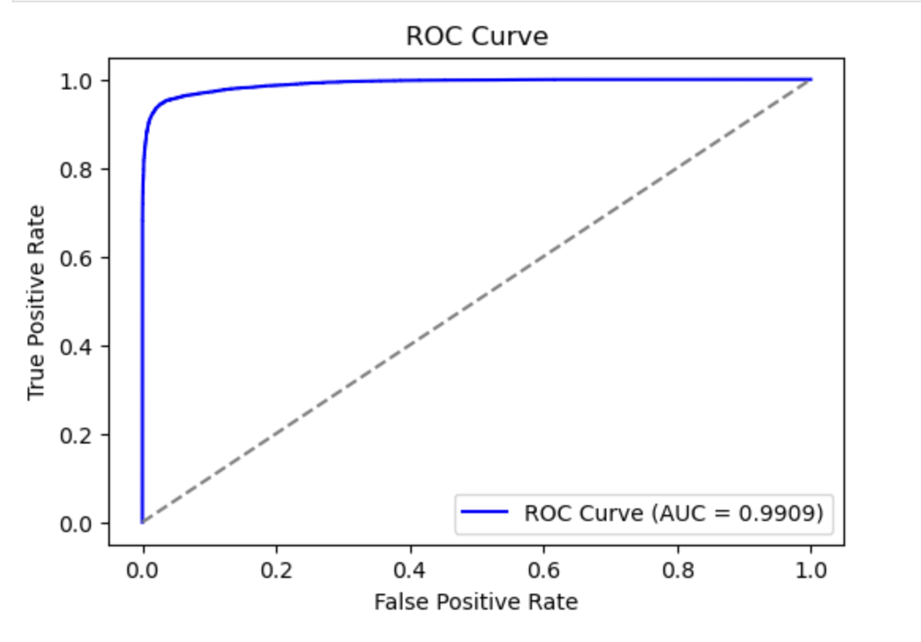
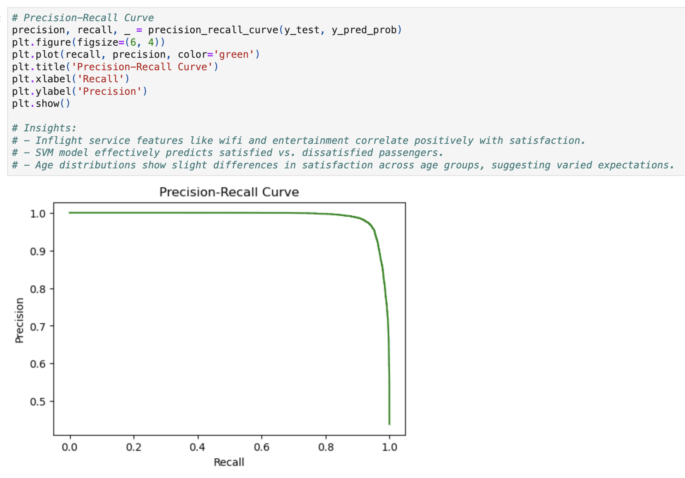
SVM Performance Metrics
High True Positives and True Negatives: Most predictions were correct.
Low Misclassifications: Few false positives and false negatives.
Result: The model reliably separates satisfied and dissatisfied passengers.
High AUC: Indicates strong performance in distinguishing between classes.
Curve Shape: Close to the top-left corner, showing high accuracy across thresholds.
Good Balance: Maintains high precision and recall for satisfied predictions.
Large Area: Confirms effective model performance, especially useful with imbalanced classes.

Slide 23
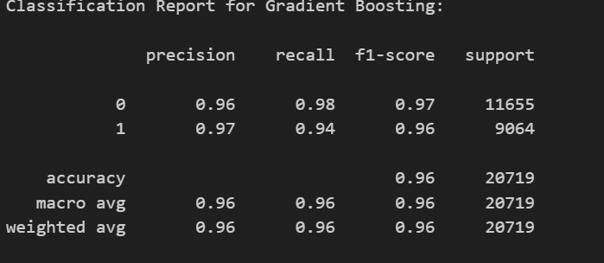
Gradient Boosting
Accuracy: The model correctly predicts the satisfaction level of 96% of the passengers.
Precision: The model has high precision for both classes, indicating accurate positive predictions.
Recall: The model is particularly good at identifying dissatisfied passengers (class 0) with a high recall.
F1-Score: The F1-score of 96% indicates a good balance between precision and recall for both classes.

Slide 24
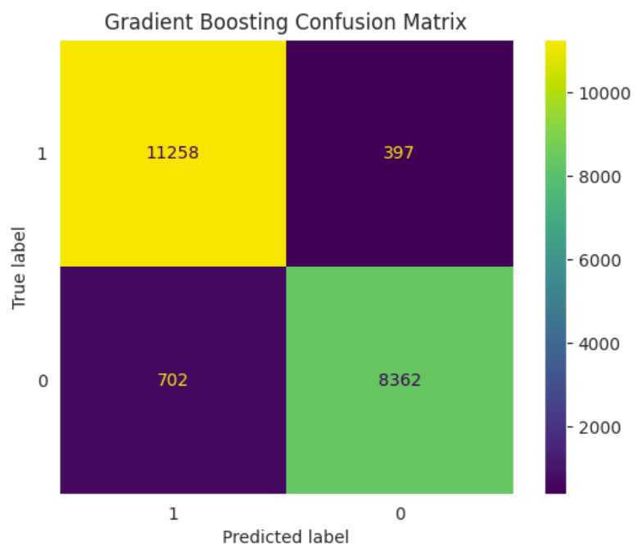
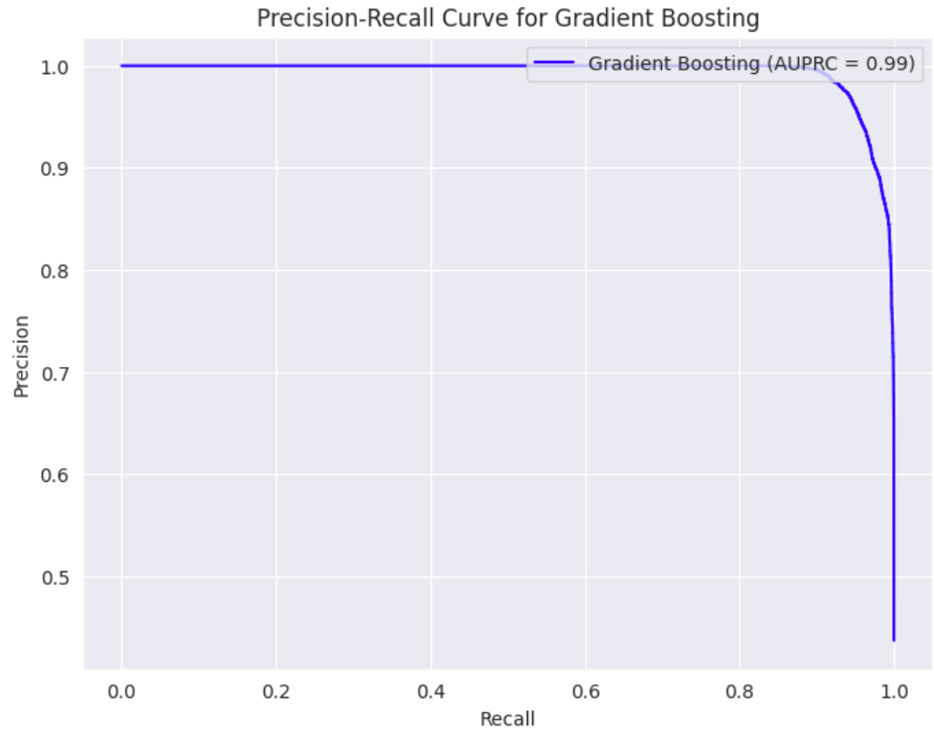
GB Performance Metrics
High Accuracy: The model correctly classifies the majority of passengers, as indicated by the high values on the diagonal of the confusion matrix.
Balanced Performance: The model performs well on both classes, with similar numbers of true positives and true negatives.
Low False Positives and False Negatives: The off-diagonal values, representing incorrect classifications, are relatively low, suggesting the model's accuracy in predicting both satisfied and dissatisfied passengers.
High AUPRC: The large area under the precision-recall curve (AUPRC) indicates the model's ability to accurately identify positive instances (satisfied passengers) while minimizing false positives.
Consistent Performance: The curve maintains a high precision level even as recall increases, suggesting the model's robustness in various threshold settings.

Slide 25
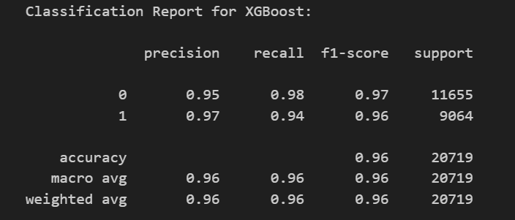
XGBoost(eXtreme Gradient Boosting)
Accuracy: 96% - The model correctly predicts the satisfaction level of 96% of the passengers. This is a very good accuracy rate.
Precision: 96% - When the model predicts a passenger to be satisfied, it is correct 96% of the time. This indicates a high precision rate.
Recall: 96% - The model correctly identifies 96% of the satisfied passengers. This indicates a high recall rate.
F1-Score: 96% - The F1-score is the harmonic mean of precision and recall, providing a balanced measure of the model's performance. This high F1-score indicates that the model performs well in both precision and recall.

Slide 26
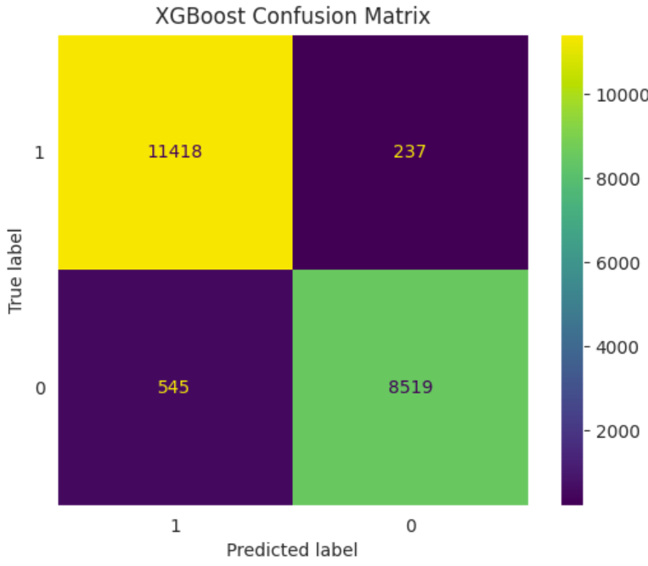
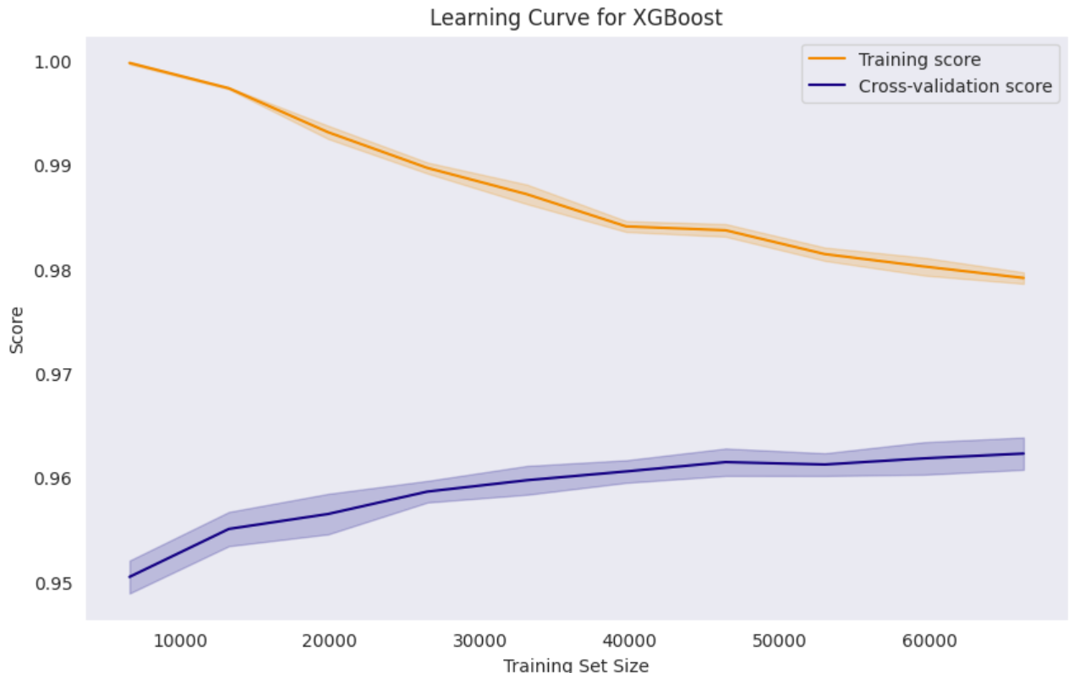
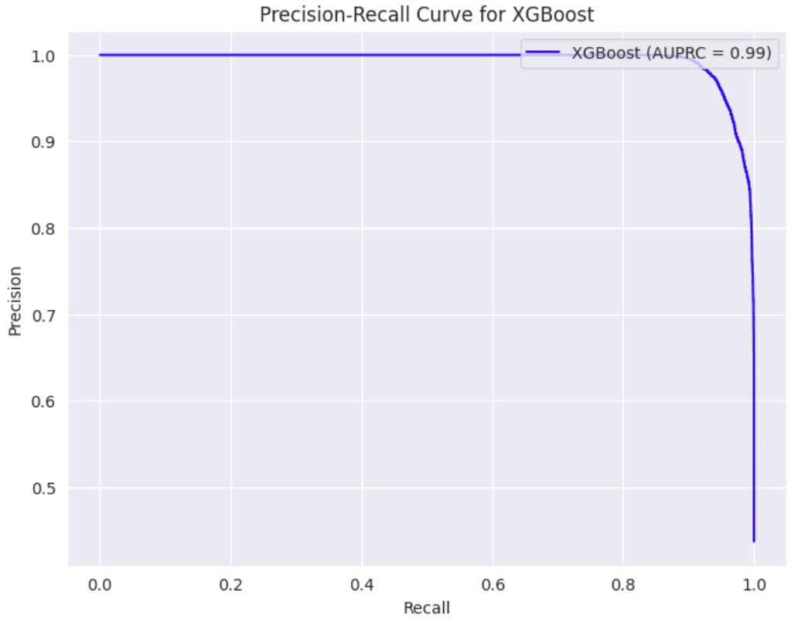
XGB Performance Metrics
High True Positives and True Negatives: The model correctly identifies a large number of both satisfied and dissatisfied passengers
Low Misclassifications: The model minimizes errors in classifying passengers.
Balanced Performance: The model performs equally well on both classes of passengers.
The model exhibits a high performance on the training set but struggles to generalize to unseen data, as evidenced by the significant gap between the training and cross-validation scores.
This suggests potential overfitting and a need for further regularization or model complexity reduction.
Good Balance: The model balances precision and recall effectively.
Large Area: The model’s strong performance is confirmed by the large area under the curve especially valuable when dealing with imbalanced datasets where precision is crucial.

Slide 27
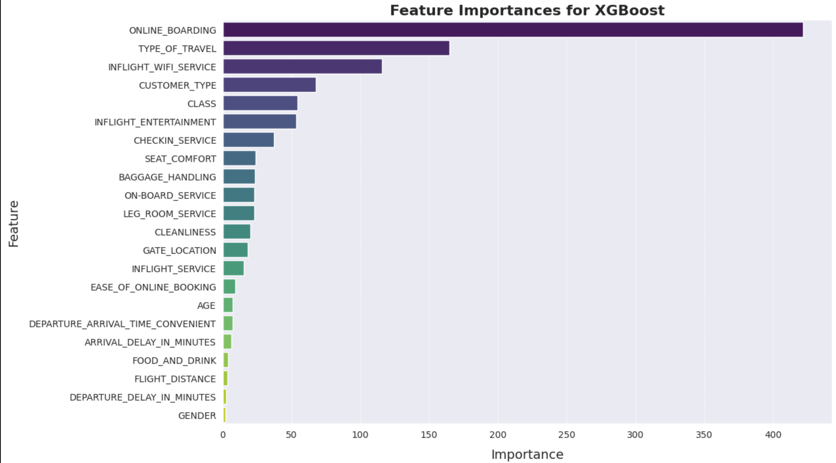
Feature Importance and Model Comparison
Model Comparison:
XGBoost:
- Slightly higher AUPRC score, suggesting a potential edge in overall performance.
- Fewer `n_estimators` (100 vs. 200 for Gradient Boosting), potentially leading to faster predictions.
- Conservative approach with `subsample` and `colsample_bytree` parameters, potentially mitigating overfitting.
- The learning curve shows a slight gap between the training and cross-validation scores, indicating some overfitting, but it's not significant.
Gradient Boosting:
- Strong performance comparable to XGBoost.
- More `n_estimators`, potentially leading to higher accuracy but potentially slower predictions.

Slide 28
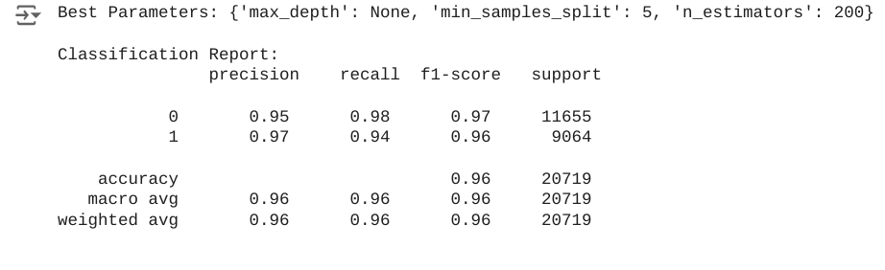
Random Forest
Model Fine-Tuned (with Grid Search CV)
Observation
Shows strong performance in predicting customer satisfaction, achieving a high F1-score of 0.96. This score indicates a good balance between precision and recall, meaning the model effectively minimizes false positives and false negatives.
Model Summary
GridSearchCV is used for hyperparameter tuning
Best Parameters:
min_samples_split: 5
n_estimators: 200
test_size=0.2, random_state=42
Accuracy: 96% – High performance

Slide 29
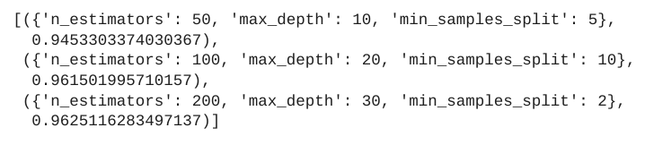
Random Forest
Manual Hyperparameter Tuning (n_estimators, max_depth, and min_samples_split)
Observed that increasing n_estimators and adjusting min_samples_split led to optimal F1-scores, confirming the robustness of the chosen parameters

Slide 30
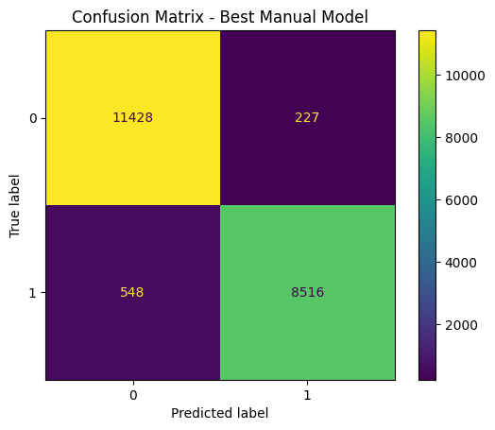
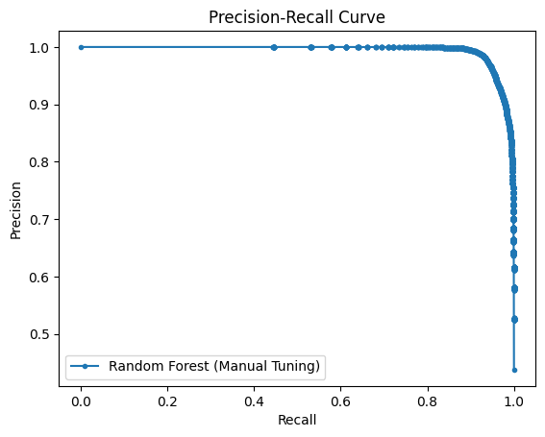
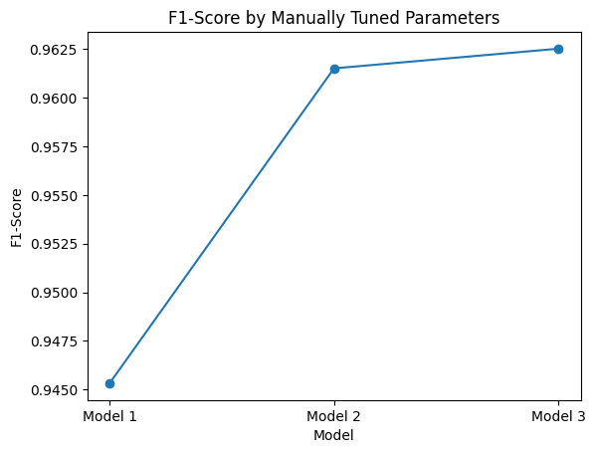
Random Forest
Shows: Distribution of true positives, true negatives, false positives, and false negatives
Insight: High accuracy with minimal misclassifications
Conclusion: Model reliably predicts the target class, achieving a strong F1-score
Shows: Trade-off between precision and recall across thresholds
Insight: Strong balance between precision and recall
Conclusion: Model effectively minimizes both false positives and false negatives
Shows: Comparison of F1-scores for different hyperparameter settings
Insight: Higher n_estimators and max_depth improve F1-score
Conclusion: Optimal parameter selection enhances model robustness and reliability

Slide 31
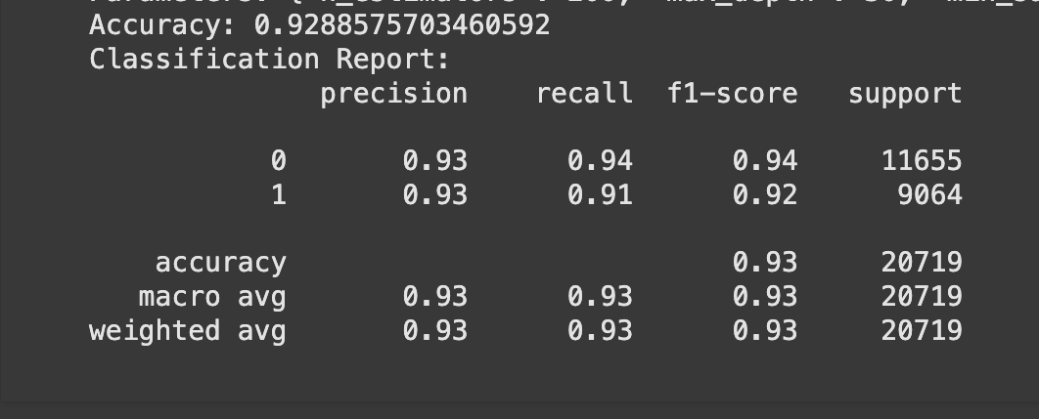
ADA BOOST
Accuracy: 92.89%, indicating the overall correct predictions out of total predictions.
Precision, Recall, F1-Score:
For class 0 : Precision = 0.93, Recall = 0.94, F1-Score = 0.94, with 11,655 instances.
For class 1 : Precision = 0.93, Recall = 0.91, F1-Score = 0.92, with 9,064 instances.
Average Metrics:
Macro Average: Precision, Recall, F1-Score = 0.93.
Weighted Average: Precision, Recall, F1-Score = 0.93.

Slide 32
Parameters: {'n_estimators': 50, 'max_depth': 10, 'min_samples_split': 5}
In the AdaBoost model:
n_estimators=50: Sets the model to use 50 boosting rounds, balancing accuracy and computational efficiency.
max_depth=10 (for base estimator) and min_samples_split=5: Limits the complexity of each base learner, reducing overfitting by creating simpler decision trees.

Slide 33
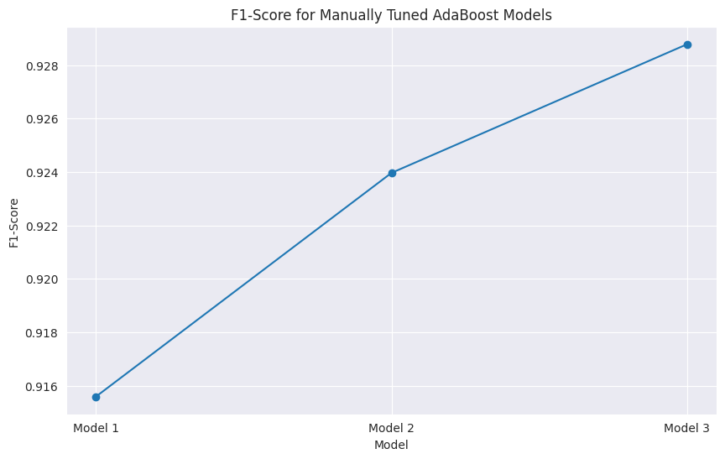
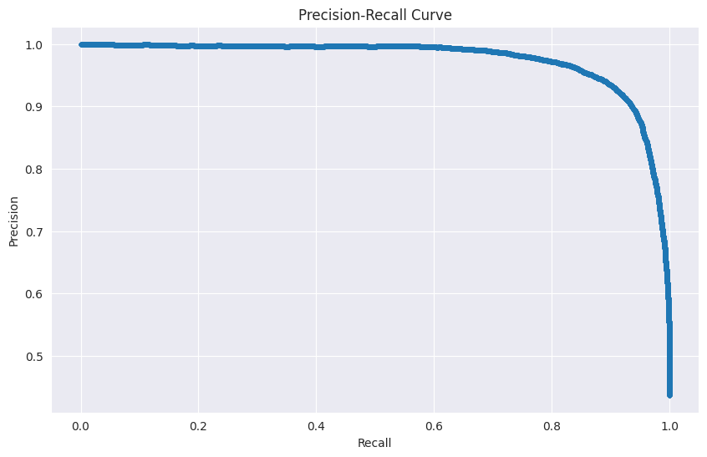
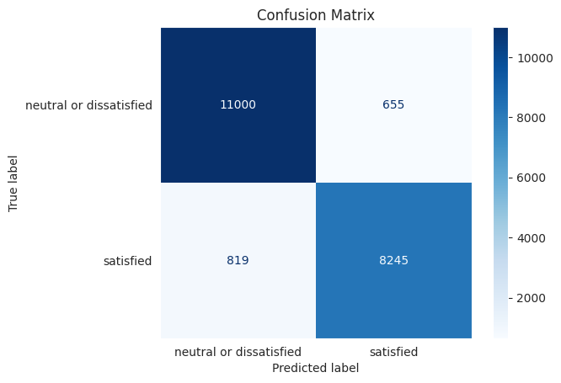
F1-score across three AdaBoost models, indicating that successive parameter tuning has enhanced model performance. Model 3 achieves the highest F1-score, suggesting it has the best balance between complexity and generalization.
The confusion matrix shows that the model correctly classified 11,000 neutral or dissatisfied passengers and 8,245 satisfied ones, with relatively low misclassification rates of 655 and 819, respectively. This indicates strong performance in distinguishing between satisfied and dissatisfied passengers.
The precision-recall curve shows high precision across most recall values, indicating that the model performs well in identifying satisfied passengers with minimal false positives. However, precision slightly decreases as recall approaches 1, reflecting a trade-off at higher recall levels.

Slide 34
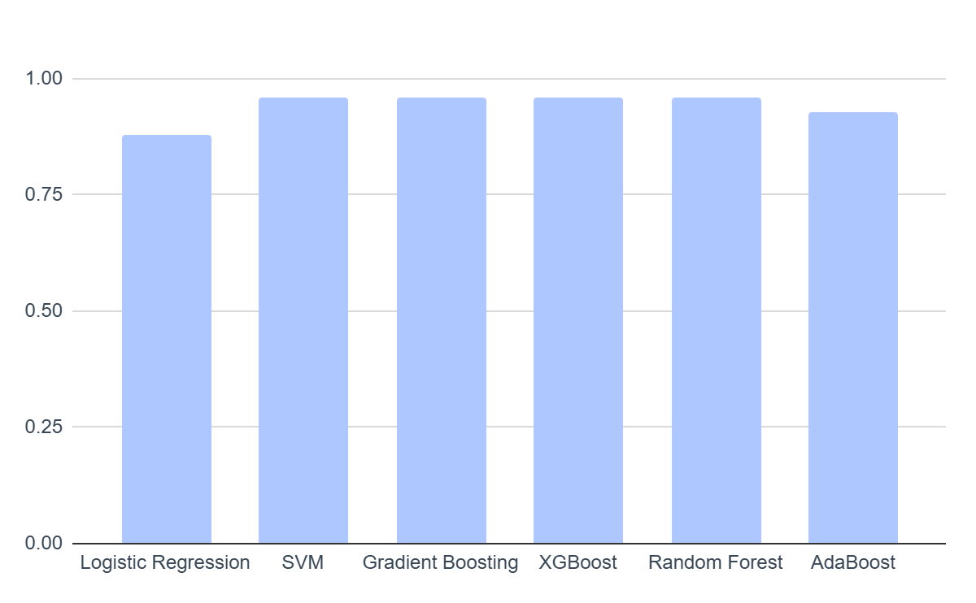
Model Accuracy Summary

Slide 35
Observations & Solution
05

Slide 36
Observations & Solution
Satisfaction is influenced by complex, non-linear interactions among variables.
Tree-based ensemble model outperform linear-based models such as logistic regression.
EDA and modeling results prove the dataset is solvable in terms of predicting airline customer satisfaction with high accuracy.

Slide 37
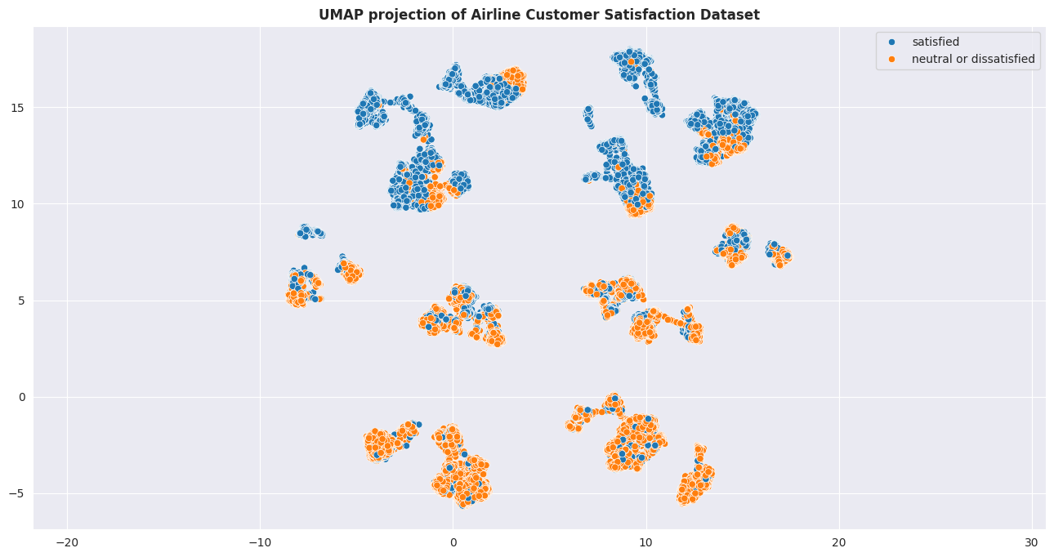
UMAP Visualization
Class mix example # 1
There are several points classified as “neutral or dissatisfied” within the “satisfied” cluster.
Class mix example # 2
There are a few points scattered within the “neutral or dissatisfied” cluster that are classified as “satisfied”.
Figure 1: UMAP visualization demonstrating difficulty separating the target label in a linear fashion. Many of the clusters are mixed between “neutral or dissatisfied” and “satisfied”. This observation is in alignment with the model performance observed from logistic regression. The model cannot be improved past 88.2% accuracy because the dataset is not linearly separable enough.

Slide 38
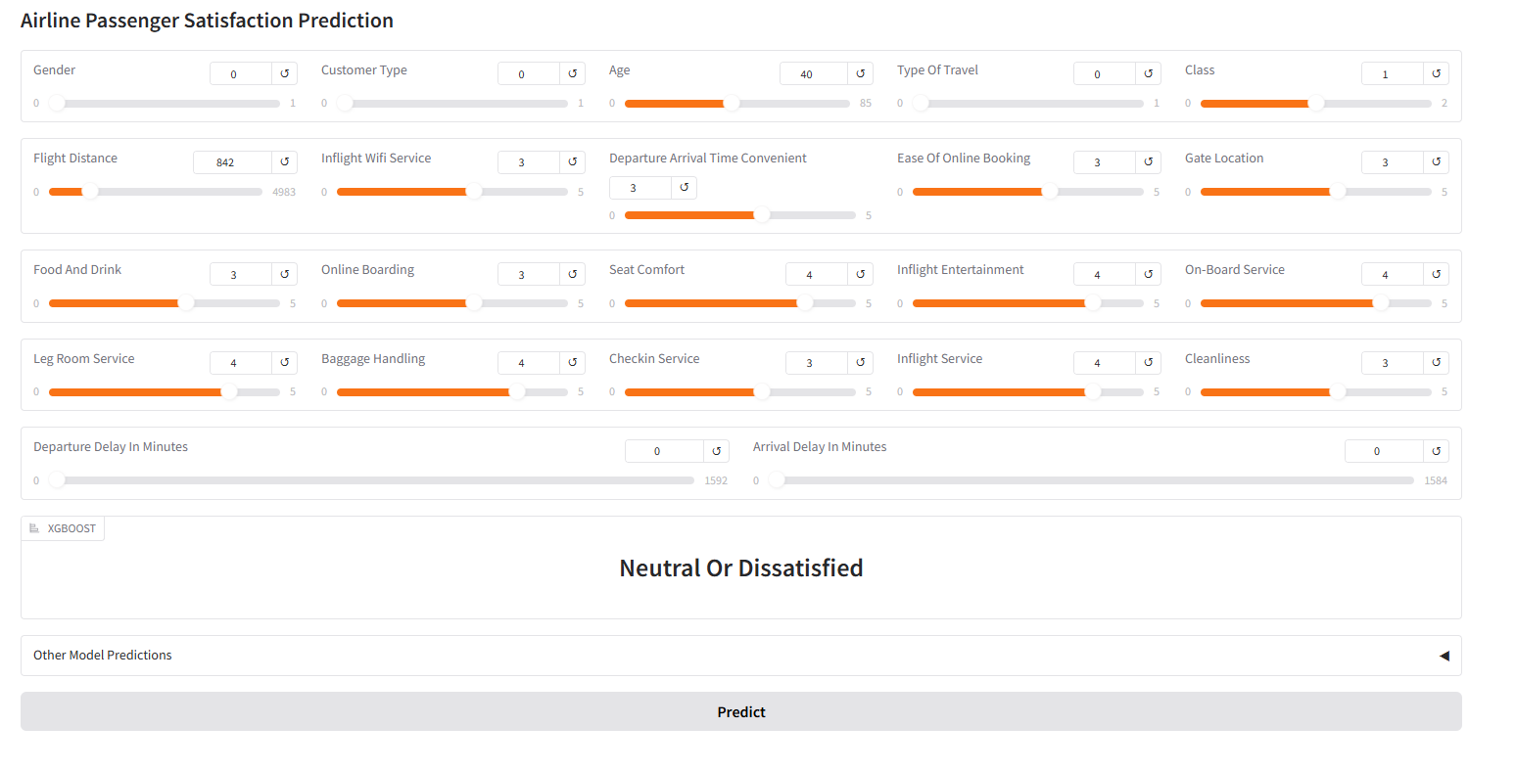
Demo
https://82e81b3c263fde35f9.gradio.live/

Slide 39
Future Work
06

Slide 40
Future Work
What could be done differently:
Use of reusable abstracted pipelines to streamline model training and inference.
Use of MLFlow or AutoML for iterative model experiments and optimization.
Halving Grid Search or Halving Random Search for more efficient use of computational resources and exploring larger hyperparameter space.
Other data exploration techniques:
Experimenting with different model-based imputation strategies (e.g., KNN).
Next steps:
Cohesive data curation pipeline.
Combine best models as stacking ensemble.

Slide 41
Questions?

